Slide 1
Module 4 Semiconductor devices

Slide 2


1. semiconductor theory

Slide 3
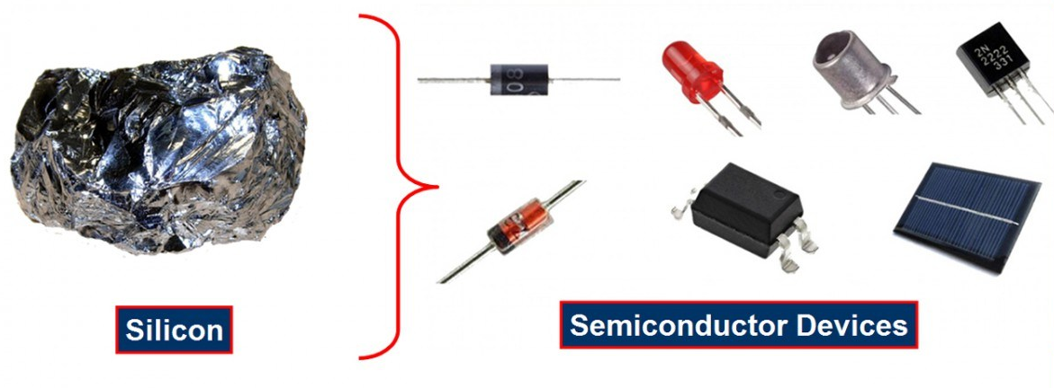
Semiconductor Devices

Slide 4
Semiconductor Devices
Electronic Devices are all about handling information i.e. high-speed transmission, acquisition and processing in fields of industries and manufacturing, communications, arts, medicine and even in warfare.
Even though an electronic system is manufactured with the help of conductors, insulators and semiconductors, the semiconductors are considered the backbone of electronics.
Over the last 70 years, semiconductors became a crucial element in the manufacturing of electronics.
The Semiconductor device is made up of a material that is neither a good conductor nor a good insulator, it is called a semiconductor.
Such devices have established wide applications because of their reliability, compactness, and low cost.

Slide 5
Semiconductor devices
These are discrete components which are used in power devices, compactness optical sensors, and light emitters, including solid-state lasers.
They have a wide range of current and voltage handling capabilities, with current ratings more than 5,000 amperes and voltage ratings more than 100,000 volts.
Semiconductor devices are nothing but electronic components that exploit the electronic properties of semiconductor materials, like as silicon, germanium, and gallium arsenide, as well as organic semiconductors.

Slide 6
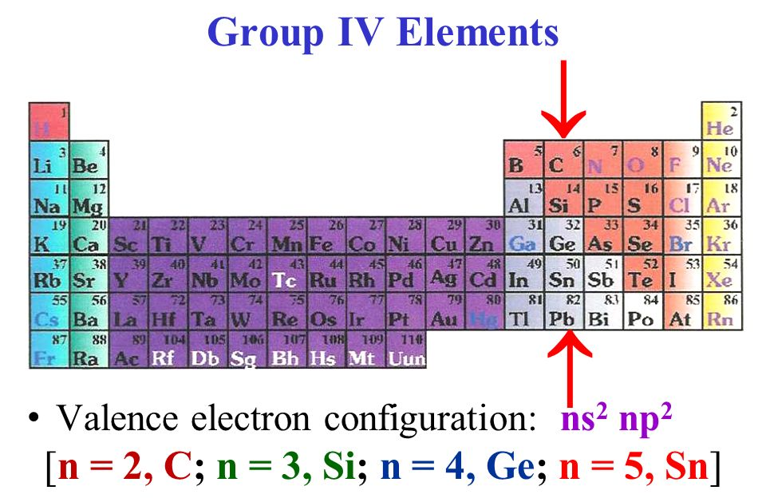
Semiconductor material
Traditionally, group IV elements like Silicon (Si) and Germanium (Ge) are considered the Elemental Semiconductor Materials i.e. semiconductors with only single atom species.

Slide 7
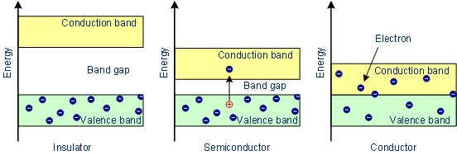
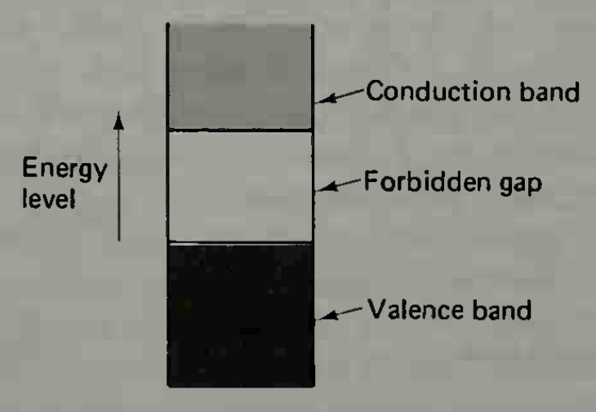
Semiconductor Material
As seen from the energy band diagrams, insulator have a wide forbidden band gap, semiconductors have a narrow forbidden band gap and conductors have no forbidden band gap.

Slide 8
Semiconductor material
In case of Insulators, there are practically no electron in the conduction band of energy levels, and the valance band is filled. Also, the forbidden gap is so wide that it would require the application of very large amount of energy to cause an electron to cross from the valance band to conduction band.
For semiconductors, the valance band is usually full and there may be no electron in the conduction band. The semiconductor forbidden gap is very narrow than that of insulator, and the application of small amounts of energy can raise electrons from valance band to the conduction band.
In case of conductors, there is no forbidden gap, and the valance and conduction bands overlap. For this reason, very large number of electrons are available for conduction.

Slide 9
Semiconductor material
Semiconductor materials are useful by their behaviour which can be easily manipulated by the addition of impurities is known as doping.
Doping is generally performed to the semiconductor materials, where an impurity is introduced into its structure to change the structural as well as electrical properties.
A pure semiconductor is known as Intrinsic Semiconductor while an impure or doped semiconductor is known as Extrinsic Semiconductor.
When the number of free electrons in the semiconductor structure is increased after doping, the semiconductor is known as n-type semiconductor. Similarly, if the holes are increased, it is known as p-type semiconductor.

Slide 10
Types of Semiconductor Devices
The following is a small list of some of the commonly used semiconductor devices. Based on the physical structure of the device, the following list is categorized into Two-terminal Devices and Three-terminal Devices.
Two-terminal Semiconductor Devices: Diode, Schottky Diode, Light Emitting Diode (LED), DIAC, Zener Diode etc
Three-terminal Semiconductor Devices: Bipolar Transistor, Field Effect Transistor, Insulated Gate Bipolar Transistor (IGBT) etc
There are also a few four-terminal semiconductors like Optocoupler (Photocoupler) and Hall-effect Sensor.

Slide 11
2. PN Junction
Basics of a PN Junction,
How a PN Junction is formed,
Characteristics of PN Junction

Slide 12
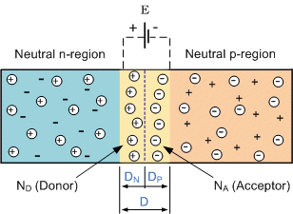
PN Junction Theory
A PN-junction is formed when an N-type material is fused together with a P-type material creating a semiconductor diode
However, if we join (or fuse) these two semiconductor materials together they behave in a very different way merging together and producing what is generally known as a “PN Junction”.
When the N-type semiconductor and P-type semiconductor materials are first joined together a very large density gradient exists between both sides of the PN junction.
The result is that some of the free electrons from the donor impurity atoms begin to migrate across this newly formed junction to fill up the holes in the P-type material producing negative ions.

Slide 13
PN Junction Theory
However, because the electrons have moved across the PN junction from the N-type silicon to the P-type silicon, they leave behind positively charged donor ions ( ND ) on the negative side and now the holes from the acceptor impurity migrate across the junction in the opposite direction into the region where there are large numbers of free electrons.
As a result, the charge density of the P-type along the junction is filled with negatively charged acceptor ions (NA), and the charge density of the N-type along the junction becomes positive.
This charge transfer of electrons and holes across the PN junction is known as diffusion.
The width of these P and N layers depends on how heavily each side is doped with acceptor density NA, and donor density ND, respectively.

Slide 14
PN Junction Theory
This process continues back and forth until the number of electrons which have crossed the junction have a large enough electrical charge to repel or prevent any more charge carriers from crossing over the junction.
Eventually a state of equilibrium (electrically neutral situation) will occur producing a “potential barrier” zone around the area of the junction as the donor atoms repel the holes and the acceptor atoms repel the electrons.
Since no free charge carriers can rest in a position where there is a potential barrier, the regions on either sides of the junction now become completely depleted of any more free carriers in comparison to the N and P type materials further away from the junction.
This area around the PN Junction is now called the Depletion Layer.

Slide 15
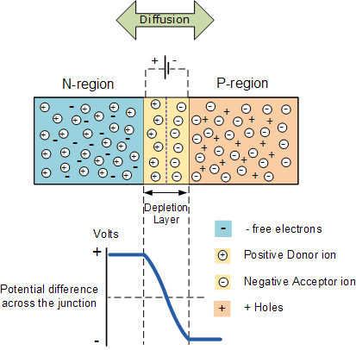
The PN junction
The total charge on each side of a PN Junction must be equal and opposite to maintain a neutral charge condition around the junction.
If the depletion layer region has a distance D, it therefore must therefore penetrate into the silicon by a distance of Dp for the positive side, and a distance of Dn for the negative side giving a relationship between the two of:
Dp*NA = Dn*ND
in order to maintain charge neutrality also called equilibrium.

Slide 16
3. PN Junction Diode

Slide 17
PN Junction Diode
Diode is a semiconductor device, which conduct the current in one direction only. Two terminals: anode and cathode.
Construction of Diode
In a piece of semiconductor material, if one half is doped by P-type and the other half is doped by N-type impurity, a PN junction is formed. The plane dividing the two halves or zones is called PN junction.
The N-type has high concentration of free electrons while P-type has high concentration of holes. Therefore at the junction there is a tendency for the free electrons to diffuse over to the P-side and holes to the N-side (process called diffusion).
The net opposite charge in each layer prevents further diffusion into that layer. Thus a barrier is set up near the junction which prevents further movement of charge carriers. This is called as potential barrier (0.3V or germanium and 0.7V for silicon).

Slide 18
Symbol, circuit diagram and V-I characteristics of Diode

Slide 19
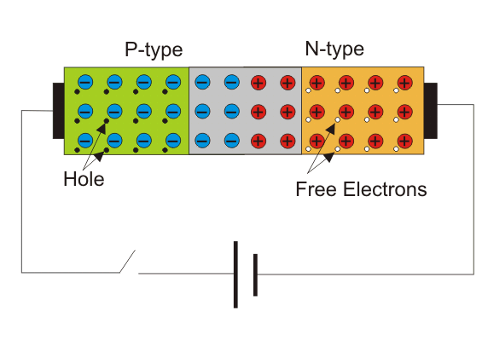

Working of Diode - Unbiased Diode
N-side will have a significant number of free electrons, and very few holes (due to thermal excitation) whereas the p side will have a high concentration of holes and very few free electrons.
Due to this, a process called diffusion takes place.
In this process free electrons from n side will diffuse (spread) into the p side and recombine with holes present there, leaving positive immobile (not moveable) ions in n side and creating negative immobile ions in the p-type side of the diode.
The region is called as depletion region due to the “depletion” of free carriers in the region.
Due to the presence of these positive and negative ions a static electric field called as barrier potential is created across the PN junction of the diode.
It is called "barrier potential" because it acts as a barrier and opposes the further migration of holes and free electrons across the junction.

Slide 20
Working of Diode - biased Diode
Forward Biased
Reverse Biased

Slide 21
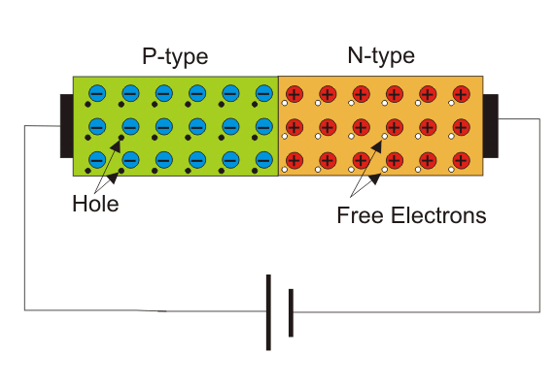
Forward Biased Diode
When the positive polarity of supply is connected to the anode – the diode is forward biased and it conducts.
If forward applied voltage increases from zero, the diode will start conducting only applied the voltage reaches just above the barrier potential or forward biased voltage of the junction.

Slide 22
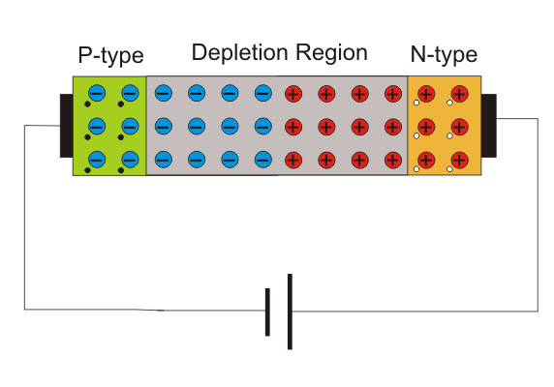
Reverse Biased Diode
When the positive polarity of supply is connected to the cathode – the diode is reversed biased and it does not conduct.
If the reverse-biasing voltage is sufficiently large than breakdown voltage, the diode is in reverse-breakdown region and large current flows though it.
As the magnitude of the reverse voltage increases, the kinetic energy of the minority charge carriers also increase.
These fast-moving electrons collide with the other atoms in the device to knock-off some more free electrons from them.
The free electrons so released further release much more free electrons from the atoms by breaking the covalent bonds.
This process is termed as carrier multiplication and leads to a considerable increase in the flow of current through the p-n junction.
The associated phenomenon is called Avalanche Breakdown.

Slide 23
1. Semiconductor Theory
Semiconductor
Insulators, Semiconductors and Conductors (Energy level, Valance band & Conduction band)
Semiconductor Materials – Group IV Elements
Doping
Intrinsic & Extrinsic Semi Conductors
p-type & n-type semi conductors
Semiconductor Devices
Types of Semiconductor Devices – Two Terminal, Three Terminal and Four Terminal Devices

Slide 24
2. PN Junction
PN Junction
How PN Junction Formed
Diffusion
Potential Barrier
Depletion Layer
Neutral Charge Condition

Slide 25
3. PN Junction Diode
PN Junction Diode (conduct the current in one direction only)
Construction of Diode
Diffusion
Potential Barrier
Symbol, VI Characteristics
Unbiased Diode
Biased Diode
Forward Biased
Reverse Biased

Slide 26
4. Application of Diode - Rectifiers
Halfwave Rectifier & Full Wave Rectifier

Slide 27
Rectifiers
The main application of p-n junction diode is in rectification circuits.
These circuits are used to describe the conversion of a.c signals to d.c in power supplies.
Diode rectifier gives an alternating voltage which pulsates in accordance with time.
The filter smoothes the pulsation in the voltage and to produce d.c voltage, a regulator is used which removes the ripples.
There are two primary methods of diode rectification:
Half Wave Rectifier
Full Wave Rectifier

Slide 28
Half Wave Rectifier
In a half-wave rectifier, one half of each a.c input cycle is rectified.
When the p-n junction diode is forward biased, it gives little resistance and when it is reversing biased it provides high resistance.
During one-half cycles, the diode is forward biased when the input voltage is applied and in the opposite half cycle, it is reverse biased.
During alternate half-cycles, the optimum result can be obtained.

Slide 29
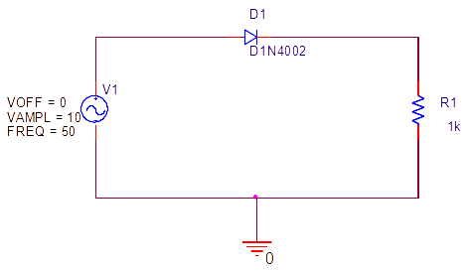
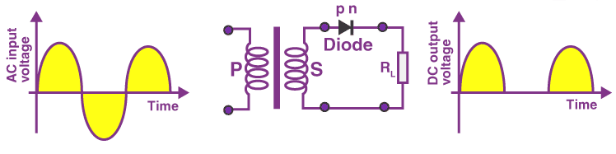
Working of Half Wave Rectifier
The half-wave rectifier has both positive and negative cycles.
During the positive half of the input, the current will flow from positive to negative which will generate only a positive half cycle of the a.c supply.
In the second half cycle, the current will flow from negative to positive and the diode will be reverse biased.
Thus, at the output side, there will be no current generated, and we cannot get power at the load resistance.

Slide 30
Characteristics of Half Wave Rectifier
1. Ripple Factor
2. DC Current
3. DC Output Voltage
4. Form factor
5. Rectifier Efficiency
Advantages
Disadvantages
Applications

Slide 31

Half Wave Rectifier – Ripple Factor
Ripples are the oscillations that are obtained in DC which is corrected by using filters such as inductors and capacitors.
These ripples are measured with the help of the ripple factor and are denoted by γ. Ripple factor tells us the number of ripples presents in the output DC.
Higher the ripple factor, more is the oscillation at the output DC and lower is the ripple factor, less is the oscillation at the output DC.
Ripple factor is the ratio of RMS value of the AC component of the output voltage to the DC component of the output voltage.

Slide 32


Half Wave Rectifier – Characteristics
DC Current
Imax is the maximum DC load current
DC Output Voltage
The output DC voltage appears at the load resistor RL which is obtained by multiplying output DC voltage with the load resistor RL.
The output DC voltage is given as:
VSmax is the maximum secondary voltage
Form Factor
The form factor is the ratio of RMS value to the DC value. For a half-wave rectifier, the form factor is 1.57.
Rectifier Efficiency
Rectifier efficiency is the ratio of output DC power to the input AC power. For a half-wave rectifier, rectifier efficiency is 40.6%.

Slide 33
Advantages of Half Wave Rectifier
Affordable
Simple connections
Easy to use as the connections are simple
Number of components used are less
Disadvantages of Half Wave Rectifier
Ripple production is more
Harmonics are generated
Utilization of the transformer is very low
The efficiency of rectification is low
Applications of Half Wave Rectifier
Power rectification: Half wave rectifier is used along with a transformer for power rectification as powering equipment.
Signal demodulation: Half wave rectifiers are used for demodulating the AM signals.
Signal peak detector: Half wave rectifier is used for detecting the peak of the incoming waveform.

Slide 34
Full Wave Rectifier
Full-wave rectifier circuits are used for producing an output voltage or output current which is purely DC.
The main advantage of a full-wave rectifier over half-wave rectifier is that such as the average output voltage is higher in full-wave rectifier, there is less ripple produced in full-wave rectifier when compared to the half-wave rectifier.
The full-wave rectifier utilizes both halves of each a.c input. When the p-n junction is forward biased, the diode offers low resistance and when it is reversing biased it gives high resistance.
The circuit is designed in such a manner that in the first half cycle if the diode is forward biased then in the second half cycle it is reverse biased and so on.

Slide 35
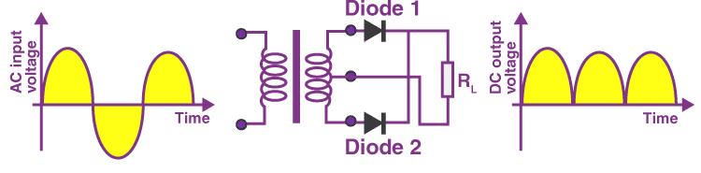
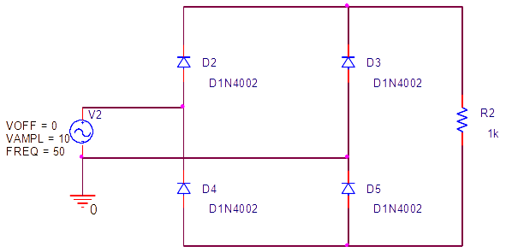
Full wave rectifier

Slide 36



Characteristics of Full Wave Rectifier
Ripple Factor
DC Current
DC Output Voltage
Form Factor - The form factor of a full-wave rectifier is given as 1.11
Rectifier Efficiency - The rectifier efficiency of a full-wave rectifier is 81.2%.
Types of Full Wave Rectifier
There are two main types of full-wave rectifiers, and they are:
Two diodes full-wave rectifier circuit (requires a center-tapped transformer and is used in vacuum tubes)
Bridge rectifier circuit (doesn’t require a centre-tapped transformer and is used along with transformers for efficient usage)

Slide 37
Advantages of Full Wave Rectifier
The rectifier efficiency of a full-wave rectifier is high
The power loss is very low
Number of ripples generated are less
Disadvantages of Full Wave Rectifier
Very expensive
Applications of Full Wave Rectifier
Following are the uses of full-wave rectifier:
Full-wave rectifiers are used for supplying polarized voltage in welding and for this bridge rectifiers are used.
Full-wave rectifiers are used for detecting the amplitude of modulated radio signals.

Slide 38
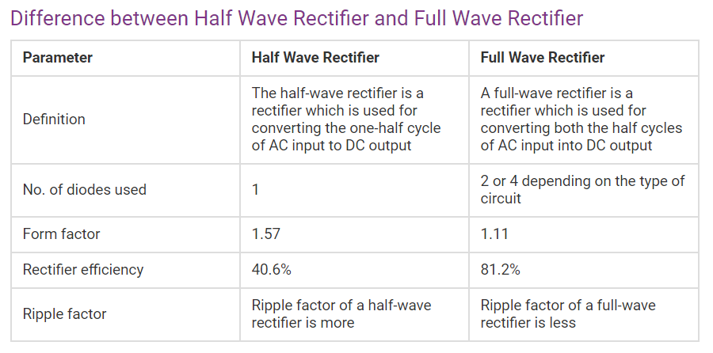

Slide 39
quiz
The p-region has a greater concentration of __________ as compared to the n-region in a P-N junction.
a) holes
b) electrons
c) both holes & electrons
d) phonons
A

Slide 40
quiz
A p-type semiconductor material is doped with ____________ impurities whereas a n-type semiconductor material is doped with __________ impurities
a) acceptor, donor
b) acceptor, acceptor
c) donor, donor
d) donor, acceptor
A

Slide 41
quiz
In the p & n regions of the p-n junction the _________ & the ___________ are the majority charge carriers respectively.
a) holes, holes
b) electrons, electrons
c) holes, electrons
d) electrons, holes
C

Slide 42
quiz
The n-region has a greater concentration of _________ as compared to the p-region in a P-N junction diode.
a) holes
b) electrons
c) both holes & electrons
d) phonons
B

Slide 43
quiz
Which of the below mentioned statements is false regarding a p-n junction diode?
a) Diode are uncontrolled devices
b) Diodes are rectifying devices
c) Diodes are unidirectional devices
d) Diodes have three terminals
D

Slide 44
quiz
When a physical contact between a p-region & n-region is established which of the following is most likely to take place?
a) Electrons from N-region diffuse to P-region
b) Holes from P-region diffuse to N-region
c) Both of the above mentioned statements are true
d) Nothing will happen
C

Slide 45
quiz
Which of the following is true in case of a forward biased p-n junction diode?
a) The positive terminal of the battery sucks electrons from the p-region
b) The positive terminal of the battery injects electrons into the p-region
c) The negative terminal of the battery sucks electrons from the p-region
d) None of the above mentioned statements are true
A

Slide 46
quiz
Power diode is __________
a) a three terminal semiconductor device
b) a two terminal semiconductor device
c) a four terminal semiconductor device
d) a three terminal analog device
B

Slide 47
quiz
The V-I Characteristics of the diode lie in the
a) 1st & 2nd quadrant
b) 1st & 3rd quadrant
c) 1st & 4th quadrant
d) Only in the 1st quadrant
B

Slide 48
quiz
A diode is said to be reversed biased when the
a) cathode is positive with respect to the anode
b) anode is positive with respect to the cathode
c) cathode is negative with respect to the anode
d) both cathode & anode are negative
A

Slide 49
quiz
A diode is said to be forward biased when the
a) cathode is positive with respect to the anode
b) anode is positive with respect to the cathode
c) anode is negative with respect to the anode
d) both cathode & anode are positive
B

Slide 50
quiz
Efficiency of a full wave rectifier is _________
a) 50%
b) 46%
c) 70%
d) 81.2%
D

Slide 51
quiz
Form factor of a half wave rectifier is
a) 1.11
b) 1.57
c) 1.21
d) 1.31
B

Slide 52
quiz
Efficiency of a half wave rectifier is
a) 50%
b) 60%
c) 40.6%
d) 46%
C

Slide 53
quiz
In a half wave rectifier, the sine wave input is 200sin300t. The average value of output voltage is?
a) 57.876V
b) 67.453V
c) 63.694V
d) 76.987V
C

Slide 54
quiz
A single-phase full wave mid-point type diode rectifier requires __________ number of diodes whereas bridge type requires _________
a) 1,2
b) 2,4
c) 4,8
d) 3,2
B

Slide 55
quiz
A single-phase full wave rectifier is a
a) single pulse rectifier
b) multiple pulse rectifier
c) two pulse rectifier
d) three pulse rectifier
C

Slide 56
Overview
Semiconductor Theory
PN Junction
PN Junction Diode
Application of Diode – HW & FW Rectifier
Zenor Diode
Application of Zenor Diode – Voltage Regulator

Slide 57
5. Zenor diode

Slide 58
Zenor Diode
Zener diodes, also known as breakdown diodes are heavily doped semiconductor devices that are designed to operate in the reverse direction.
When the voltage across its terminals is reversed and the potential reaches the Zener Voltage (knee voltage), the junction will break down and the current flows in the reverse direction.
This effect is known as the Zener Effect.
Zener diodes are manufactured with a great variety of Zener voltages (Vz) and some are even made variable.

Slide 59
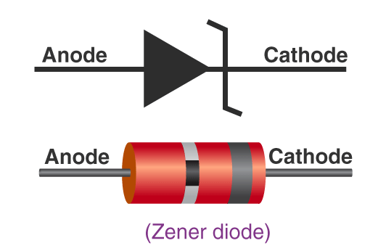
Zener Diode Circuit Symbol
The Zener diode circuit symbol places two tags at the end of the bar – one in the upward direction and the other in the lower direction as shown in the figure.
This helps in distinguishing Zener diodes from other forms of diodes within the circuit.

Slide 60
Working of Zener Diode
The Zener diode operates just like a normal diode when it is forward-biased.
However, when connected in reverse biased mode, a small leakage current flows through the diode.
As the reverse voltage increases to the predetermined breakdown voltage (Vz), a current starts flowing through the diode.
The current increases to a maximum, which is determined by the series resistor, after which it stabilizes and remains constant over a wide range of applied voltage.

Slide 61
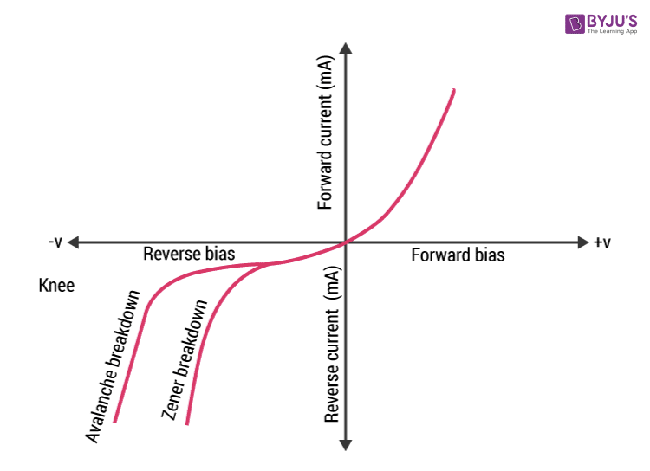
V-I Characteristics of Zener Diode
When reverse-biased voltage is applied to a Zener diode, it allows only a small amount of leakage current until the voltage is less than Zener voltage.

Slide 62
types of breakdown
For a Zener diode there are two types of breakdown:
Zener breakdown
Avalanche breakdown

Slide 63
Zener Breakdown vs Avalanche Breakdown
The Zener effect is dominant in voltages up to 5.6 volts and the avalanche effect takes over above that.
They are both similar effects, the difference being that the Zener effect is a quantum phenomenon and the avalanche effect is the movement of electrons in the valence band like in any electric current.
Avalanche effect also allows a larger current through the diode than the Zener effect

Slide 64
V-I characteristics of a Zener diode
The V-I characteristics of a Zener diode can be divided into two parts as follows:
Forward Characteristics
Reverse Characteristics
Forward Characteristics
The first quadrant in the graph represents the forward characteristics of a Zener diode. From the graph, we understand that it is almost identical to the forward characteristics of any other P-N junction diode.
Reverse Characteristics
When a reverse voltage is applied to a Zener voltage, initially a small reverse saturation current Io flows across the diode. This current is due to thermally generated minority carriers. As the reverse voltage is increased, at a certain value of reverse voltage, the reverse current increases drastically and sharply. This is an indication that the breakdown has occurred. We call this voltage breakdown voltage or Zener voltage and it is denoted by Vz.

Slide 65
Zener Diode Specifications
Some commonly used specifications for Zener diodes are as follows:
Zener/Breakdown Voltage – The Zener or the reverse breakdown voltage ranges from 2.4 V to 200 V, sometimes it can go up to 1 kV while the maximum for the surface-mounted device is 47 V.
Current Iz (max) – It is the maximum current at the rated Zener Voltage (Vz – 200μA to 200 A)
Current Iz (min) – It is the minimum value of current required for the diode to breakdown.
Power Rating – It denotes the maximum power the Zener diode can dissipate. It is given by the product of the voltage of the diode and the current flowing through it.
Temperature Stability – Diodes around 5 V have the best stability
Voltage Tolerance – It is typically ±5%
Zener Resistance (Rz) – It is the resistance to the Zener diode exhibits.

Slide 66
advantages of a Zener diode
The size of the Zener diode is so small that it can be used in smaller circuits and also in cell phones.
Zener diodes are less expensive when compared to other diodes.
Zener diodes can be used for controlling, regulating, and stabilizing the voltage in the circuit.
These diodes have a very high-performance standard.
The compatibility of the Zener diodes is good that they are used in regulating voltage.

Slide 67
Application of Zener Diode
Zener diode as a voltage regulator
Zener diode in over-voltage protection
Zener diode in clipping circuits

Slide 68
6. Application of Zenor diode – Voltage Regulator

Slide 69
Zener Diode as a Voltage Regulator
Zener diode is a silicon semiconductor with a p-n junction that is specifically designed to work in the reverse biased condition.
When forward biased, it behaves like a normal signal diode, but when the reverse voltage is applied to it, the voltage remains constant for a wide range of currents.
Due to this feature, it is used as a voltage regulator in d.c. circuit.
The primary objective of the Zener diode as a voltage regulator is to maintain a constant voltage.
Let us say if Zener voltage of 5 V is used then, the voltage becomes constant at 5 V, and it does not change.

Slide 70
What is a Voltage Regulator
A voltage regulator is a device that regulates the voltage level.
It essentially steps down the input voltage to the desired level and keeps it at that same level during the supply.
This ensures that even when a load is applied the voltage doesn’t drop.
The voltage regulator is used for two main reasons, and they are:
To vary or regulate the output voltage
To keep the output voltage constant at the desired value in spite of variations in the supply voltage.
Voltage regulators are used in computers, power generators, alternators to control the output of the plant.

Slide 71
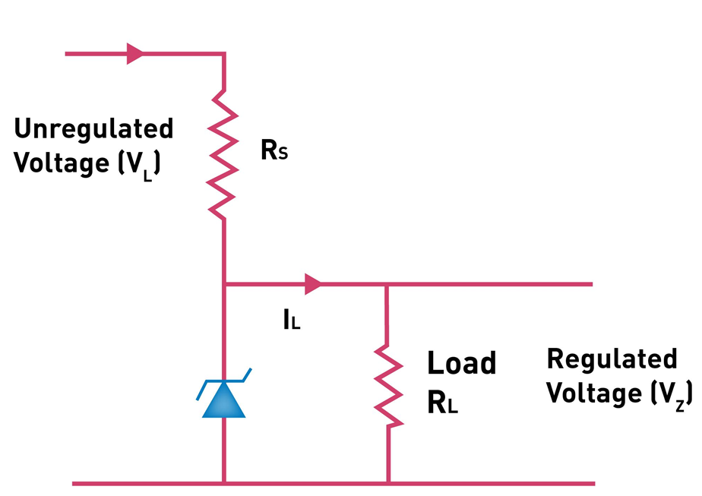
Zener Diode as a Voltage Regulator
The circuit diagram of a voltage regulator using a Zener diode.
There is a series resistor connected to the circuit in order to limit the current into the diode.
It is connected to the positive terminal of the d.c. It works in such a way the reverse-biased can also work in breakdown conditions.
We do not use ordinary junction diode because the low power rating diode can get damaged when we apply reverse bias above its breakdown voltage.
When the minimum input voltage and the maximum load current is applied, the Zener diode current should always be minimum.

Slide 72
Operation
Since the input voltage and the required output voltage is known, it is easier to choose a Zener diode with a voltage approximately equal to the load voltage, i.e. VZ = VL.
The value of the series resistor is written as RS = (VL − VZ)IL
Current through the diode increases when the voltage across the diode tends to increase which results in the voltage drop across the resistor.
Similarly, the current through the diode decreases when the voltage across the diode tends to decrease. Here, the voltage drop across the resistor is very less, and the output voltage results normally.

Slide 73
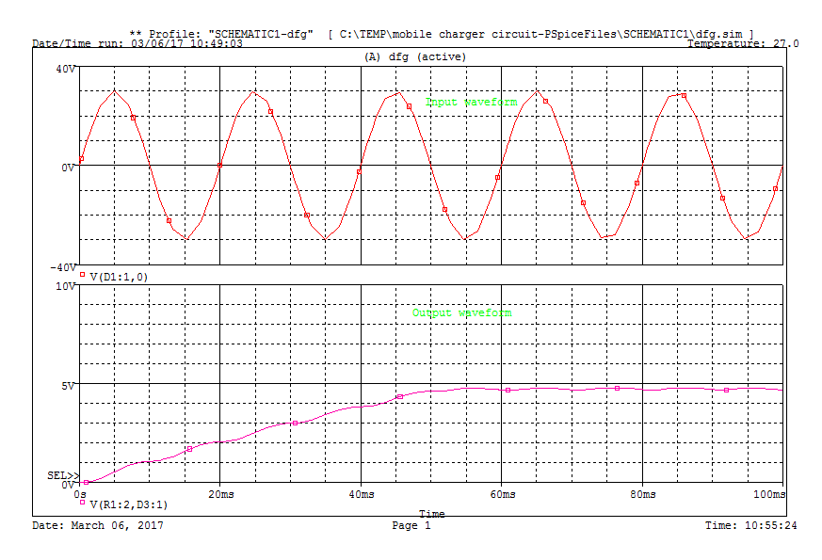
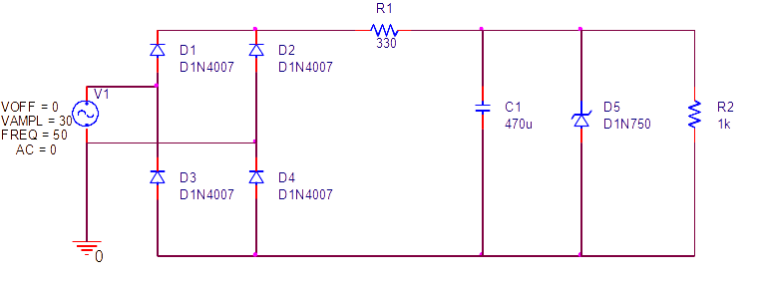
Experiment

Slide 74
quiz
What is the level of doping in Zener Diode?
a) Lightly Doped
b) Heavily Doped
c) Moderately Doped
d) No doping

Slide 75
QUIZ
Zener Diode is mostly used as ____________
a) Half-wave rectifier
b) Full-wave rectifier
c) Voltage Regulator
d) LED

Slide 76
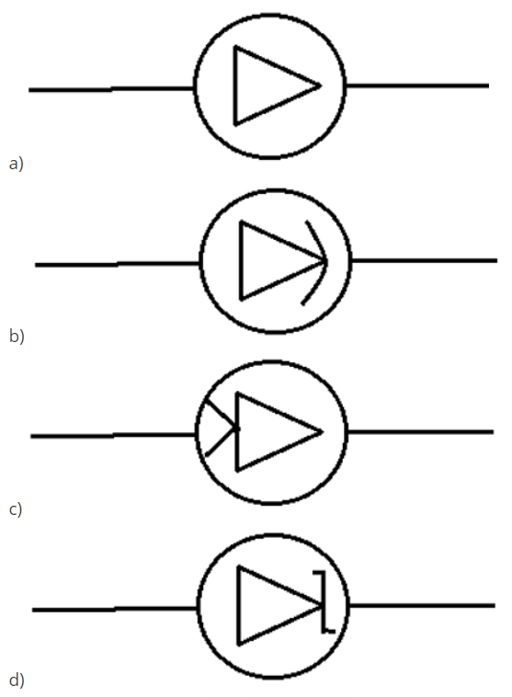
quiz
Which of the following is the correct symbol for the zener diode?

Slide 77
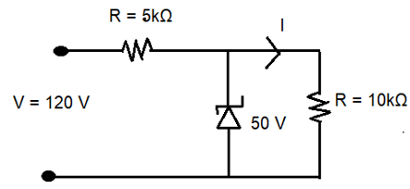
quiz
In the circuit, what is the output voltage?
a) 50 V
b) 70 V
c) 120 V
d) 170 V

Slide 78
END OF Module
Semiconductor Theory
PN Junction
PN Junction Diode
Application of Diode – HW & FW Rectifier
Zenor Diode
Application of Zenor Diode – Voltage Regulator

